Slide 1
SUMMARY
PROBLEM, ALGORITHM, PROGRAM

Slide 2
SUMMARY
PROBLEM, ALGORITHM, PROGRAM
RESOURCE (Running Time, Memory Used)

Slide 3
SUMMARY
PROBLEM, ALGORITHM, PROGRAM
RESOURCE (Running Time, Memory Used)
ENGINEERING APPROXIMATIONS
  Just count program steps
  Only worry about “hot spots”
  Figure out how resource usage varies as a function of the input size

Slide 4
MATHEMATICAL FRAMEWORK
Establish a relative order among the growth rate of functions.
Use functions to model the “approximate” and “asymptotic” (running time) behaviour of algorithms.

Slide 5
MATHEMATICAL FRAMEWORK
DEFN: We say T(N) = O(f(N)) (order or (big) o(h) f(N)) if there are positive constants c and n₀ such that
T(N) ≤ c • f(N)
when N ≥ n₀

Slide 6
MATHEMATICAL FRAMEWORK
DEFN: We say T(N) = O(f(N)) (order or (big) o(h) f(N)) if there are positive constants c and n₀ such that
T(N) ≤ c • f(N)
when N ≥ n₀
cf(N)
T(N)
n₀
N

Slide 7
MATHEMATICAL FRAMEWORK
DEFN: We say T(N) = Ω(f(N)) (omega of f(N)) if there are positive constants c and n₀ such that
T(N) ≥ c • f(N)
when N ≥ n₀

Slide 8
MATHEMATICAL FRAMEWORK
DEFN: We say T(N) = Ω(f(N)) (omega of f(N)) if there are positive constants c and n₀ such that
T(N) ≥ c • f(N)
when N ≥ n₀
T(N)
cf(N)
n₀
N

Slide 9
MATHEMATICAL FRAMEWORK
DEFN: We say T(N) = Θ(f(N)) (theta of f(N)) if T(N) = O(f(N)) and T(N) = Ω(f(N))

Slide 10
MATHEMATICAL FRAMEWORK
DEFN: We say T(N) = Θ(f(N)) (theta of f(N)) if T(N) = O(f(N)) and T(N) = Ω(f(N))
c’f(N)
T(N)
cf(N)
n₀
n₀’
N

Slide 11
MATHEMATICAL FRAMEWORK
DEFN: We say T(N) = o(f(N)) (little o(h) of f(N)) if T(N) = O(f(N)) and T(N) ≠Θ (f(N))
T(N) grows strictly slower than f(N)

Slide 12
MATHEMATICAL FRAMEWORK
DEFN: We say T(N) = o(f(N)) (little o(h) of f(N)) if T(N) = O(f(N)) and T(N) ≠Θ(f(N))
cf(N)
T(N)
n₀
N

Slide 13
EXAMPLES
Let’s see whether 1000N = O(N²)
    1000N ≤ c • N² when N ≥ n₀
1000N is larger than N² for small values of N but eventually N² dominates.
For n₀ =1000 and c = 1,
  1000N ≤ N² when N ≥ 1000
So 1000 N = O(N²)

Slide 14
EXAMPLES
Let’s see whether 1000N = O(N²)
  1000N ≤ c • N² when N ≥ n₀
1000N is larger than N² for small values of N but eventually N² dominates. For n₀ ≥ 1000 and c = 1, N² ≥ 1000 N , so 1000 N = O(N²)
Note that we have other choices for c and n₀ (c = 100 and n₀ = 10), but only one pair is sufficient.

Slide 15
EXAMPLES
1000N = O(N²)
1000N is larger than N² for small values of N but eventually N² dominates. For n₀ ≥ 1000 and c = 1, N² ≥ 1000 N , so 1000 N = O(N²)
Note that we have other choices for c and n₀ (c = 100 and n₀ = 10), but only one pair is sufficient.
Basically what we are saying is that 1000N grows slower than N².

Slide 16
EXAMPLES
Let’s see whether 0.001 N² =Ω(N)
  0.001N² ≥ c • N when N ≥ n₀
0.001 N² is smaller than N for small values of N , but eventually 0.001 N² dominates.
For n₀ =1000 and c = 1
  0.001 N² ≥ N when N ≥ 1000
So, 0.001 N² = Ω(N)
So, 0.001 N² grows at a faster rate than that of N.

Slide 17
EXAMPLES
5 N² = O(N²) (c = 6 and n₀ = 1)

Slide 18
EXAMPLES
5 N² = O(N²) (c = 6 and n₀ = 1)
5 N² = Ω(N²) (c = 4 and n₀ = 1)

Slide 19
EXAMPLES
5 N² = O(N²) (c = 6 and n₀ = 1)
5 N² = Ω(N²) (c = 4 and n₀ = 1)
So 5N² = Θ(N²), both functions grow at the same rate.

Slide 20
SOME USEFUL FUNCTIONS
Growth rate of some useful functions
Function | Name
c | Constant
log N | Logarithmic
log² N | Log-squared
N | Linear
N log N
N² | Quadratic
N³ | Cubic
c^{N} | Exponential

Slide 21
SOME USEFUL FUNCTIONS
Growth rate of some useful functions
Function | Name
c | Constant
log N | Logarithmic
log² N | Log-squared
N | Linear
N log N
N² | Quadratic
N³ | Cubic
c^{N} | Exponential
SUBLINEAR

Slide 22
SOME USEFUL FUNCTIONS
Growth rate of some useful functions
Function | Name
c | Constant
log N | Logarithmic
log² N | Log-squared
N | Linear
N log N
N² | Quadratic
N³ | Cubic
c^{N} | Exponential
POLYNOMIAL

Slide 23
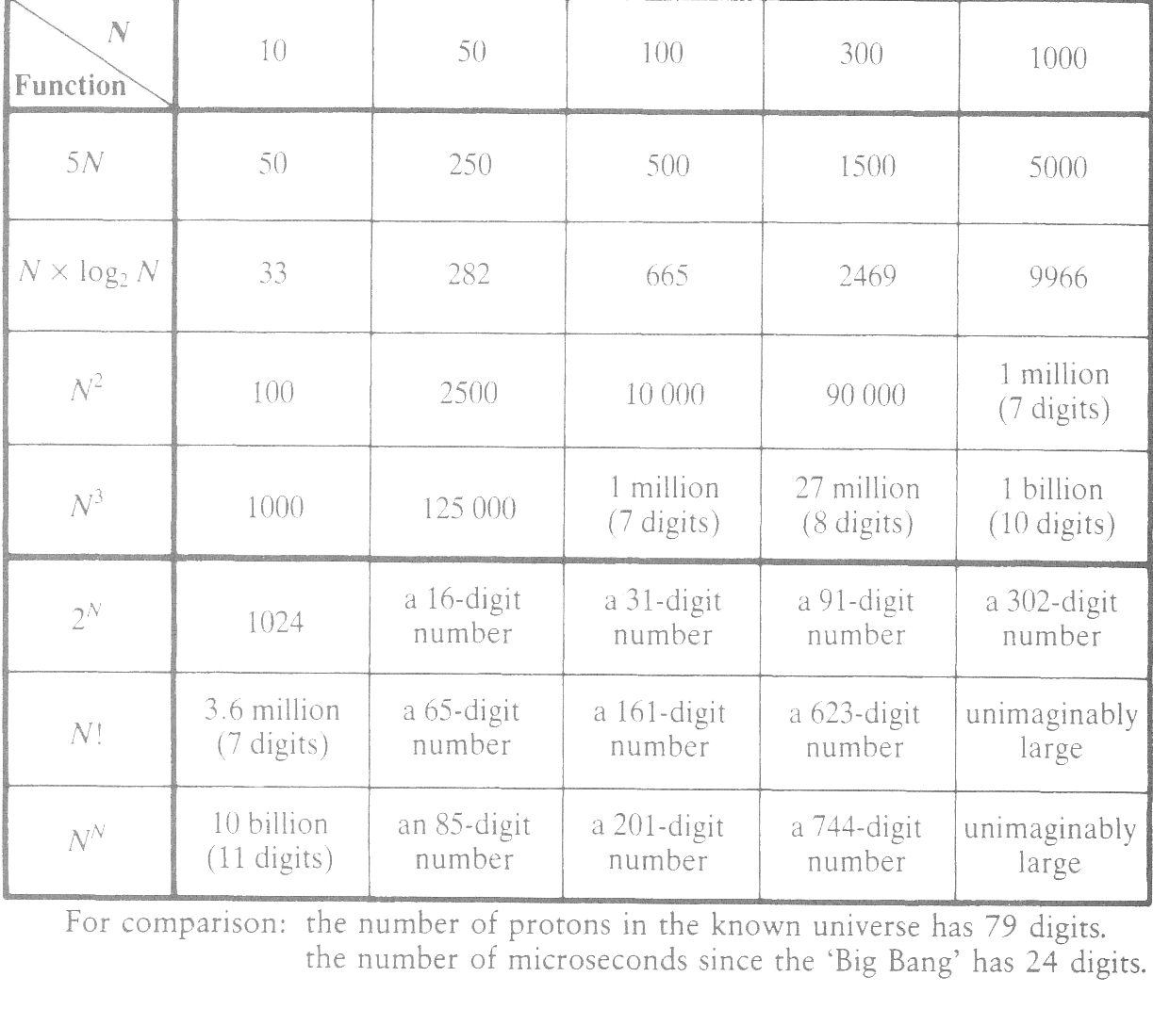
How Large is Really Large?

Slide 24
OBSERVATIONS
Never include constants or lower-order terms in the big-oh notation
  Constants do NOT matter!
    E.g., instead of O(2N + 2) use O(N)
  Lower order terms do NOT matter!
    E.g., instead of O(N² + 2N + 2) use O(N²)
Get as tight as possible in the big-oh notation
  N = O(N) = O(N²) = O(N³) = O (N⁴) = O(N^{N}) = …
  But, N = O(N) is as tight as possible

Slide 25
RULES
Rule 1
If T₁(N) = O(f(N)) and T₂(N) = O(g(N)) then
  (a) T₁(N) + T₂(N) = max (O(f(N)) , O(g(N)) )
  (b) T₁(N) * T₂(N) = O( f(N) * g (N))

Slide 26
RULES
Rule 2
If T(N) is a polynomial of degree k, then
T(N) = Θ (N ^{k})

Slide 27
RULES
Rule 3
log ^{k} N = O(N) for any constant k.
Logarithms grow very slowly.

Slide 28
ANALYZING COMPLEXITY
Rule: for loops
The running time is at most the running time of the statements in the loop (including the tests) times the number of iterations.

Slide 29
ANALYZING COMPLEXITY
Rule: for loops
The running time is at most the running time of the statements in the loop (including the tests) times the number of iterations.
  for (i = 1; i <= N; i++) {
  ........
  ........
  }
} O(F(N))

Slide 30
ANALYZING COMPLEXITY
Rule: for loops
The running time is at most the running time of the statements in the loop (including the tests) times the number of iterations.
  for (i = 1; i <= N; i++) {
  ........
  ........
  }
} O(F(N))
O(N•F(N))

Slide 31
ANALYZING COMPLEXITY
Rule: for loops
The running time is at most the running time of the statements in the loop (including the tests) times the number of iterations.
  for (i = 1; i <= N; i++) {
  ........
  ........
  }
Be careful when the loop time depends on the index
} O(F(N))
O(N•F(N))

Slide 32
For-loop example
for (i = 0 ; i < N ; i++)
for (j = 0 ; j < N; j++) {
k= i+j;
l= 2 * k;
}
⎫
⎫
⎬
⎫
⎬
⎬
O(1)
O(N•1)=O(N)
⎭
⎭
⎭
O(N•N)=O(N ²)

Slide 33
For-loop example
for (i = 1 ; i < N ; i=i*2)
for (j = 0 ; j < N; j++) {
k= i+j;
l= 2 * k;
}
⎫
⎫
⎬
⎫
⎬
⎬
O(1)
O(N•1)=O(N)
⎭
⎭
⎭
Let N = 2^{m} for some positive m
iteration | i
1 | 2⁰
2 | 2¹
3 | 2²
... | ...
m | 2^{m-1}
O( log₂N•N)=O(N • logN)

Slide 34
ANALYZING COMPLEXITY
Rule: Consecutive Statements
  The running time is the sum of the running times of individual statements

Slide 35
ANALYZING COMPLEXITY
Rule: Consecutive Statements
  The running time is the sum of the running times of individual statements
Remember that
If T₁(N) = O(f(N)) and T₂(N) = O(g(N)) then
T₁(N) + T₂(N) = max (O(f(N)) , O(g(N)) )

Slide 36
ANALYZING COMPLEXITY
Rule: Consecutive Statements
  The running time is the sum of the running times of individual statements,
Remember that
If T₁(N) = O(f(N)) and T₂(N) = O(g(N)) then
T₁(N) + T₂(N) = max (O(f(N)) , O(g(N)) )
Which means that you have to take the maximum of the running times of the statements.

Slide 37
Example
⎫
Statement 1 O(N)
Statement 2 O(N ²)
Statement 3 O(N log N)
⎬
O( N ²)
⎭

Slide 38
ANALYZING COMPLEXITY
Rule: If statements
  if (condition) then
  S1
  else
  S2
O(f_{c}(N))
O(f_{then}(N))
O(f_{else}(N))
How can we bound the running time of the if statement?
max(O(f_{c}(N)), O(f_{then}(N)), O(f_{else}(N)))

Slide 39
AN EXAMPLE
{
1 int i,j;
2 for(i=1; i <= n ; i=i*2) {
3 for(j = 0; j < i; j++) {
4 foo[i][j] = 0;
5 for (k = 0; k < n; k++) {
6 foo[i][j] = bar[k][i+j] + foo[i][j];
7 }
8 }
9 }
}
O(1)
O(n)
O(1)
O(n)

Slide 40
AN EXAMPLE
{
1 int i,j;
2 for(i=1; i <= n ; i=i*2) {
3 for(j = 0; j < i; j++) {
4 foo[i][j] = 0;
5 for (k = 0; k < n; k++) {
6 foo[i][j] = bar[k][i+j] + foo[i][j];
7 }
8 }
9 }
}
O(i•n)
O(n)

Slide 41
AN EXAMPLE
Although this loop is executed about log n times, at each iteration the time of the inner loop changes!
{
1 int i,j;
2 for(i=1; i <= n ; i=i*2) {
3 for(j = 0; j < i; j++) {
4 foo[i][j] = 0;
5 for (k = 0; k < n; k++) {
6 foo[i][j] = bar[k][i+j] + foo[i][j];
7 }
8 }
9 }
}
O(i•n)
O(n)

Slide 42
AN EXAMPLE
Although this loop is executed about log n times, at each iteration the time of the inner loop changes!
{
1 int i,j;
2 for(i=1; i <= n ; i=i*2) {
3 for(j = 0; j < i; j++) {
4 foo[i][j] = 0;
5 for (k = 0; k < n; k++) {
6 foo[i][j] = bar[k][i+j] + foo[i][j];
7 }
8 }
9 }
}
O(i•n)
O(n)

Slide 43
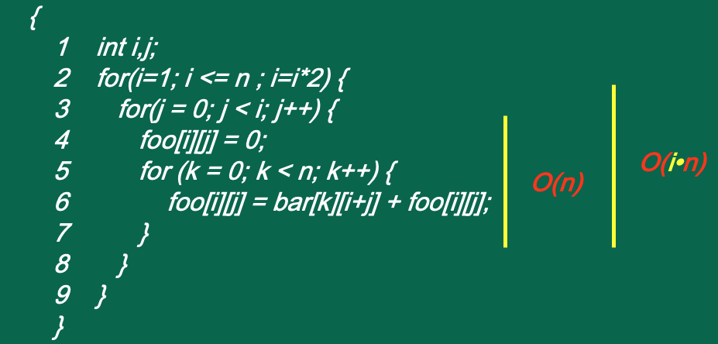
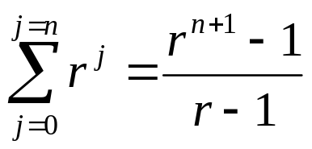





AN EXAMPLE
Let n = 2^{m} for some positive m
i | cost
1 | O(2⁰ n)
2 | O(2¹n)
4 | O(2²n)
8 | O(2³n)
... | ...
2^{m} | O(2^{m}n)

Slide 44

RECURSIVE PROGRAMS
Fibonacci Numbers
  F(0) = 0, F (1) = 1
  F(N) = F(N-1) + F(N-2) for N > 1

Slide 45
RECURSIVE PROGRAMS
Fibonacci Numbers
  F(0) = 0, F (1) = 1
  F(N) = F(N-1) + F(N-2) for N > 1
Fact (that you will learn in MATH 204)
  F(N) = (1/√5) (Φ ^{N} - Ψ ^{N} )

Slide 46
RECURSIVE PROGRAMS
Fibonacci Numbers
  F(0) = 0, F (1) = 1
  F(N) = F(N-1) + F(N-2) for N > 1
Fact (that you will learn in MATH 204)
  F(N) = (1/√5) (Φ ^{N} - Ψ ^{N} )
    Φ = (1 + √5) / 2, Ψ = (1 - √5) / 2

Slide 47
RECURSIVE PROGRAMS
Fibonacci Numbers
  F(0) = 0, F (1) = 1
  F(N) = F(N-1) + F(N-2) for N > 1
Fact (that you will learn in MATH 204)
  F(N) = (1/√5) (Φ ^{N} - Ψ ^{N} )
    Φ = (1 + √5) / 2, Ψ = (1 - √5) / 2
    (3/2) ^{N} ≤ F(N) < (5 / 3) ^{N} ( for N > 4)
    So F(N) is an exponentially growing function

Slide 48
COMPUTING FIBONACCI NUMBERS
The obvious algorithm (assume n ≥ 0)
  long int fib( int n){
  if (n <= 1)
  return( n );
  else
  return( fib (n – 1) + fib (n – 2) );
  }

Slide 49
COMPUTING FIBONACCI NUMBERS
The obvious algorithm (assume n ≥ 0)
  long int fib( int n){
  if (n <= 1)
  return( n );
  else
  return( fib (n – 1) + fib (n – 2) );
  }
How good is this algorithm?

Slide 50
COMPUTING FIBONACCI NUMBERS
The obvious algorithm (assume n ≥ 0)
  long int fib( int n){
  if (n <= 1)
  return( n );
  else
  return( fib (n – 1) + fib (n – 2) );
  }
Let T(N) is the number of statements we need to execute to compute the N^{th} Fibonacci number.

Slide 51
COMPUTING FIBONACCI NUMBERS
The obvious algorithm (assume n ≥ 0)
  long int fib( int n)
  { if (n <= 1)
  return( n );
  else
  return( fib (n – 1) + fib (n – 2) );
  }
T(0) = T(1) = 2

Slide 52
COMPUTING FIBONACCI NUMBERS
The obvious algorithm
  long int fib( int n)
  { if (n <= 1)
  return( n );
  else
  return( fib (n – 1) + fib (n – 2) );
  }
T(0) = T(1) = 2
T(N) = T(N-1) + T(N-2) + 2

Slide 53
COMPUTING FIBONACCI NUMBERS
Running time
  T(0) = T(1) = 2
  T(N) = T(N-1) + T(N-2) + 2
Fibonacci Numbers
  F(0) = 0, F (1) = 1
  F(N) = F(N-1) + F(N-2)
By induction you can show T(N) ≥ F(N) (Why is that?)
    (3/2) ^{N} ≤ F(N) < (5/3) ^{N} ( for N > 4)
T(N) ≥ (5/3) ^{N}
Which means T(N) is exponential!
Not good !!!

Slide 54
COMPUTING FIBONACCI NUMBERS
What is going on?

Slide 55
COMPUTING FIBONACCI NUMBERS
What is going on?
F(6)
F (5)
F(4)
F(3)
F(2)
F(4)
F(3)
F(2)
F(1)
F(1)
F(0)
F(3)
F(2)
F(2)
F(1)
F(1)
F(0)
F(2)
F(1)
F(1)
F(0)
F(1)
F(0)
F(1)
F(0)

Slide 56
COMPUTING FIBONACCI NUMBERS
What is going on?
F(6)
F (5)
F(4)
F(3)
F(2)
F(4)
F(3)
F(2)
F(1)
F(1)
F(0)
F(3)
F(2)
F(2)
F(1)
F(1)
F(0)
F(2)
F(1)
F(1)
F(0)
F(1)
F(0)
F(1)
F(0)
Too much redundant computation

Slide 57
COMPUTING FIBONACCI NUMBERS
The next obvious algorithm (assume n ≥ 0)
  int fib( int n)
  {int X[3];
  if (n <= 1) return(n);
  X[0]=0; X[1]=1;
  for (i = 2; i <= n; i++)
  X[i % 3] = X[(i-1) % 3] + X[(i-2) % 3];
  return X[(i-1)%3] ;
  }

Slide 58


Slide 59
COMPUTING FIBONACCI NUMBERS
The next obvious algorithm (assume n ≥ 0)
  int fib( int n)
  {int X[3];
  if (n <= 1) return(n);
  X[0]=0; X[1]=1;
  for (i = 2; i <= n; i++)
  X[i % 3] = X[(i-1) % 3] + X[(i-2) % 3];
  return X[(i-1)%3] ;
  }
% is the mod operator i%3 ≡ i mod 3

Slide 60
COMPUTING FIBONACCI NUMBERS
The next obvious algorithm (assume n ≥ 0)
  int fib( int n)
  {int X[3];
  if (n <= 1) return(n);
  X[0]=0; X[1]=1;
  for (i = 2; i <= n; i++)
  X[i % 3] = X[(i-1) % 3] + X[(i-2) % 3];
  return X[(i-1)%3] ;
  }
when i=2
0
X[0]
fib(0)
X[2]
1
X[1]
fib(1)

Slide 61
COMPUTING FIBONACCI NUMBERS
The next obvious algorithm (assume n ≥ 0)
  int fib( int n)
  {int X[3];
  if (n <= 1) return(n);
  X[0]=0; X[1]=1;
  for (i = 2; i <= n; i++)
  X[i % 3] = X[(i-1) % 3] + X[(i-2) % 3];
  return X[(i-1)%3] ;
  }
0
X[0]
fib(0)
X[2]
1
1
X[1]
fib(2)
fib(1)

Slide 62
COMPUTING FIBONACCI NUMBERS
The next obvious algorithm (assume n ≥ 0)
  int fib( int n)
  {int X[3];
  if (n <= 1) return(n);
  X[0]=0; X[1]=1;
  for (i = 2; i <= n; i++)
  X[i % 3] = X[(i-1) % 3] + X[(i-2) % 3];
  return X[(i-1)%3] ;
  }
fib(3)
2
X[0]
X[2]
1
1
X[1]
fib(2)
fib(1)

Slide 63
COMPUTING FIBONACCI NUMBERS
The next obvious algorithm (assume n ≥ 0)
  int fib( int n)
  {int X[3];
  if (n <= 1) return(n);
  X[0]=0; X[1]=1;
  for (i = 2; i <= n; i++)
  X[i % 3] = X[(i-1) % 3] + X[(i-2) % 3];
  return X[(i-1)%3] ;
  }
fib(3)
2
X[0]
X[2]
1
3
X[1]
fib(2)
fib(4)

Slide 64
COMPUTING FIBONACCI NUMBERS
The next obvious algorithm (assume n ≥ 0)
  int fib( int n)
  {int X[3];
  if (n <= 1) return(n);
  X[0]=0; X[1]=1;
  for (i = 2; i <= n; i++)
  X[i % 3] = X[(i-1) % 3] + X[(i-2) % 3];
  return X[(i-1)%3] ;
  }
2
X[0]
X[2]
5
3
X[1]
fib(5)

Slide 65
COMPUTING FIBONACCI NUMBERS
The next obvious algorithm (assume n ≥ 0)
  int fib( int n)
  {int X[3];
  if (n <= 1) return(n);
  X[0]=0; X[1]=1;
  for (i = 2; i <= n; i++)
  X[i % 3] = X[(i-1) % 3] + X[(i-2) % 3];
  return X[(i-1)%3] ; (Why?)
  }
Because i is incremented at the end of the loop before exit.

Slide 66
COMPUTING FIBONACCI NUMBERS
The next obvious algorithm (assume n ≥ 0)
  int fib( int n)
  {int X[3];
  if (n <= 1) return(n);
  X[0]=0; X[1]=1;
  for (i = 2; i <= n; i++)
  X[i % 3] = X[(i-1) % 3] + X[(i-2) % 3];
  return X[(i-1)%3] ;
  }
~N iterations each taking constant time → O(N)

Slide 67
COMPUTING FIBONACCI NUMBERS
The next obvious algorithm (assume n ≥ 0)
  int fib( int n)
  {int X[3];
  if (n <= 1) return(n);
  X[0]=0; X[1]=1;
  for (i = 2; i <= n; i++)
  X[i % 3] = X[(i-1) % 3] + X[(i-2) % 3];
  return X[(i-1)%3] ;
  }
~N iterations each taking constant time → O(N)
Much better than the O(c^{N}) algorithm, but ....

Slide 68
COMPUTING FIBONACCI NUMBERS
Can we do any better?

Slide 69
COMPUTING FIBONACCI NUMBERS
Can we do any better?
Yes, it turns out we can compute F(N) in about O(log N) steps.

Slide 70
COMPUTING FIBONACCI NUMBERS
Can we do any better?
Yes, it turns out we can compute F(N) in about O(log N) steps.
Basically we can compute
  F(N) = (1/√5) (Φ ^{N} - Ψ ^{N} )
directly without doing any real arithmetic.

Slide 71
COMPUTING FIBONACCI NUMBERS
But how????

Slide 72
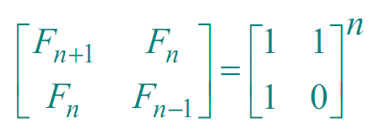
COMPUTING FIBONACCI NUMBERS
But how????
It turns out that
So if we can compute the n^{th} power of something fast, we can compute F_{n} fast.

Slide 73
COMPUTING FIBONACCI NUMBERS
But how????
First let’s look at a simple problem.
How can we compute X ^{N} fast ?

Slide 74
COMPUTING FIBONACCI NUMBERS
Let’s compute X⁴
The obvious algorithm
  X ⁴ = X * X * X * X (3 multiplications)
  X ^{N} requires N-1 multiplications
A clever algorithm
  A = X * X
  X ⁴ = A * A (requires 2 multiplications)

Slide 75
COMPUTING X^{N}
long pow (long x, int n)
{ if (n == 0) return (1)
if (isEven(n))
return(pow(x*x, n/2));
else return(x * pow( x, n – 1));
}

Slide 76
COMPUTING X^{N}
long pow (long x, int n)
{ if (n == 0) return (1)
if (isEven(n))
return(pow(x*x, n/2));
else return(x * pow( x, n – 1));
}
pow(x,17) =
x * pow(x,16) =
x * pow (x*x, 8) =
x * pow((x²)*(x²), 4) =
x * pow((x⁴)*(x⁴), 2) =
x * pow((x⁸)*(x⁸),1) =
x * pow((x¹⁶), 0) * x¹⁶ =
x * x¹⁶

Slide 77
COMPUTING X^{N}
long pow (long x, int n)
{ if (n == 0) return (1)
if (isEven(n))
return(pow(x*x, n/2));
else return(x * pow( x, n – 1));
}
At most 1 multiplication per halving

Slide 78
COMPUTING X^{N}
long pow (long x, int n)
{ if (n == 0) return (1)
if (isEven(n))
return(pow(x*x, n/2));
else return(x * pow( x, n – 1));
}
At most 1 multiplication per halving
log N halving calls
O(log N) algorithm

Slide 79
COMPUTING X^{N}
There is nothing special about taking a matrix to the n^{th} power.
Each matrix multiplication is a fixed number of scalar multiplications and additions.

Slide 80
BACK TO FIBONACCI
Can we prove that

Slide 81
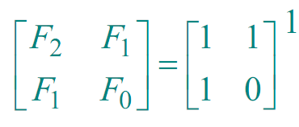
BACK TO FIBONACCI
Proof by Induction
  Basis case n=1

Slide 82
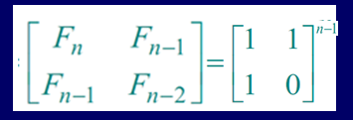
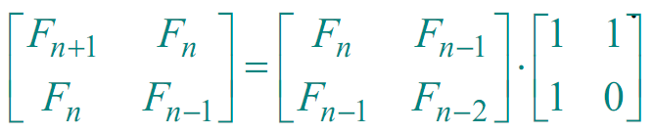
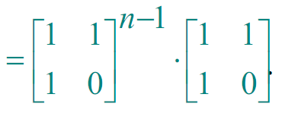
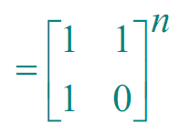
COMPUTING FIBONACCI
Assume that
Inductive case n >1

Slide 83
PROBLEMS, ALGORITHMS AND BOUNDS
To show a problem is O(f(N)): demonstrate a correct algorithm which solves the problem and takes O(f(N)) time.

Slide 84
PROBLEMS, ALGORITHMS AND BOUNDS
To show a problem is O(f(N)): demonstrate a correct algorithm which solves the problem and takes O(f(N)) time. (Usually easy!)
To show a problem is Ω(f(N)): Show that ALL algorithms solving the problem must take at least Ω f(N)) time. (Usually very hard!)

Slide 85
(Back to) MULTIPLICATION
Elementary school addition : Θ(N)
  We have an algorithm which runs in O(N) time
  We need at least Ω(N) time
Elementary school multiplication: O(N²)
  We have an algorithm which runs in O(N²) time.

Slide 86
MULTIPLICATION
* * * * * * *
X * * * * * * *
* * * * * * *
* * * * * * *
* * * * * * *
* * * * * * *
* * * * * * *
* * * * * * *
* * * * * * *
* * * * * * * * * * * * * *

Slide 87
MULTIPLICATION
⎫
⎬
⎭
N
* * * * * * *
X * * * * * * *
* * * * * * *
⎫
* * * * * * *
* * * * * * *
⎬
N²
* * * * * * *
* * * * * * *
⎭
* * * * * * *
* * * * * * *
* * * * * * * * * * * * * *

Slide 88
MULTIPLICATION
Elementary school addition : Θ(N)
Elementary school multiplication: O(N²)
Is there a clever algorithm to multiply two numbers in linear time?

Slide 89
MULTIPLICATION
Elementary school addition : Θ(N)
Elementary school multiplication: O(N²)
Is there a clever algorithm to multiply two numbers in linear time?
Possible Ph.D. Thesis!

Slide 90
FAST(ER) MULTIPLICATION
Divide and Conquer
  Divide the problem into smaller problems
  Conquer (solve) the smaller problems recursively
  Combine the answers of the smaller problems to obtain the answer for the larger problems.

Slide 91
FAST(ER) MULTIPLICATION
Divide and Conquer
  Divide the problem into smaller problems
  Conquer (solve) the smaller problems recursively
  Combine the answers of the smaller problems to obtain the answer for the larger problems.
Fundamental technique in algorithm design.

Slide 92
MULTIPLICATION
X =
a
b
Y =
c
d

Slide 93
MULTIPLICATION
X =
a
b
(N bits)
Y =
c
d
(N bits)
X = a 2^{N/2} + b
Y = c 2^{N/2} + d

Slide 94
MULTIPLICATION
X =
a
b
(N bits)
Y =
c
d
(N bits)
X = a 2^{N/2} + b
Y = c 2^{N/2} + d
Note that these are NOT really multiplications but actually shifts!

Slide 95
SHIFTS
Multiply by 2 is the same as shift left by 1 bit.

Slide 96
SHIFTS
Multiply by 2 is the same as shift left by 1 bit.
Just as Multiply by 10 is the same as shift left by 1 digit
  40 * 10 = 400

Slide 97
SHIFTS
Multiply by 2 is the same as shift left by 1 bit.
  101₂ = 5₁₀
Shifting left by 1 we get
  1010₂ = 10₁₀

Slide 98
SHIFTS
Multiply by 2 is the same as shift left by 1 bit.
  101₂ = 5₁₀
Shifting left by 1 we get
  1010₂ = 10₁₀
Shift left by n-bits = multiply by 2^{n}

Slide 99
SHIFTS
Multiply by 2 is the same as shift left by 1 bit.
  101₂ = 5₁₀
Shifting left by 1 we get
  1010₂ = 10₁₀
Shift left by n-bits = multiply by 2^{n}
Shift right by n-bits is divide by 2^{n}

Slide 100
BRIEF DIGRESSION
X =
a
b
(N bits)
X = a 2^{N/2} + b
X = 250₁₀ = 1·128 + 1· 64 + 1· 32 + 1· 16 + 1· 8 + 0·4+1· 2 + 0·1

Slide 101
BRIEF DIGRESSION
X =
a
b
(N bits)
X = a 2^{N/2} + b
X = 250₁₀ = 1·128 + 1· 64 + 1· 32 + 1· 16 + 1· 8 + 0·4+1· 2 + 0·1
X = 11111010₂
X = 1111 1010
a = 1111₂
b = 1010₂

Slide 102
BRIEF DIGRESSION
X =
a
b
(N bits)
X = a 2^{N/2} + b
X = 250₁₀ = 1·128 + 1· 64 + 1· 32 + 1· 16 + 1· 8 + 0·4+1· 2 + 0·1
X = 11111010₂
X = 1111 1010
a = 1111₂ = 15₁₀
b = 1010₂=10₁₀

Slide 103
BRIEF DIGRESSION
X =
a
b
(N bits)
X = a 2^{N/2} + b
X = 250₁₀ = 1·128 + 1· 64 + 1· 32 + 1· 16 + 1· 8 + 0·4+1· 2 + 0·1
X = 11111010₂
X = 1111 1010
a = 1111₂ = 15₁₀
b = 1010₂=10₁₀
a 2^{8/2} = 11110000₂= 240₁₀

Slide 104
BRIEF DIGRESSION
X =
a
b
(N bits)
X = a 2^{N/2} + b
X = 250₁₀ = 1·128 + 1· 64 + 1· 32 + 1· 16 + 1· 8 + 0·4+1· 2 + 0·1
X = 11111010₂
X = 1111 1010
a = 1111₂ = 15₁₀
b = 1010₂=10₁₀
a 2^{8/2} = 11110000₂= 240₁₀
X = 250₁₀ = 240 + 10

Slide 105
BRIEF DIGRESSION
X =
a
b
(N bits)
X = a 2^{N/2} + b
X = 250₁₀ = 1·128 + 1· 64 + 1· 32 + 1· 16 + 1· 8 + 0·4+1· 2 + 0·1
X = 11111010₂
X = 1111 1010
a = 1111₂ = 15₁₀
b = 1010₂=10₁₀
a 2^{8/2} = 11110000₂= 240₁₀
X = 250₁₀ = 240 + 10
You just shift 4 0s in. Takes 4 steps.

Slide 106
(Back to) MULTIPLICATION
X =
a
b
(N bits)
Y =
c
d
(N bits)
X = a 2^{N/2} + b
Y = c 2^{N/2} + d
XY = ac 2^{N} + (ad+bc)2^{N/2}+bd

Slide 107
MULTIPLICATION
X = a 2^{N/2} + b
Y = c 2^{N/2} + d
XY = ac 2^{N} + (ad+bc)2^{N/2}+bd
Length of the numbers
This is either 0 or 1
Mult(X,Y):
if |X| = |Y| = 1 return (XY);
Break X into a:b and Y into c:d;
return ( Mult(a,c)·2^{N} + (Mult(a,d) + Mult(b,c)) ·2^{N/2} +
Mult(b,d));

Slide 108
MULTIPLICATION
X = a 2^{N/2} + b
Y = c 2^{N/2} + d
XY = ac 2^{N} + (ad+bc)2^{N/2}+bd
Length of the numbers
This is either 0 or 1
Mult(X,Y):
if |X| = |Y| = 1 return (XY);
Break X into a:b and Y into c:d;
return ( Mult(a,c)·2^{N} + (Mult(a,d) + Mult(b,c)) ·2^{N/2} +
Mult(b,d));
This is an example of divide and conquer.

Slide 109
MULTIPLICATION
Mult(X,Y):
if |X| = |Y| = 1 return (XY);
Break X into a:b and Y into c:d;
return (Mult(a,c)·2^{N}+ (Mult(a,d)+Mult(b,c)) ·2^{N/2} +
Mult(b,d));
What is T(N), the time taken by Mult(X,Y) on two
N-bit numbers?

Slide 110
MULTIPLICATION
Mult(X,Y):
if |X| = |Y| = 1 return (XY);
Break X into a:b and Y into c:d;
return (Mult(a,c)·2^{N}+ (Mult(a,d)+Mult(b,c)) ·2^{N/2} +
Mult(b,d));
T(1) = k for some constant k

Slide 111
MULTIPLICATION
Mult(X,Y):
if |X| = |Y| = 1 return (XY);
Break X into a:b and Y into c:d;
return (Mult(a,c)·2^{N}+ (Mult(a,d)+Mult(b,c)) ·2^{N/2} +
Mult(b,d));
T(1) = k for some constant k
T(N) = 4 T(N/2) + k’ N for some constant k’

Slide 112
MULTIPLICATION
Mult(X,Y):
if |X| = |Y| = 1 return (XY);
Break X into a:b and Y into c:d;
return (Mult(a,c)·2^{N}+ (Mult(a,d)+Mult(b,c)) ·2^{N/2} +
Mult(b,d));
T(1) = k for some constant k
T(N) = 4 T(N/2) + k’ N for some constant k’

Slide 113
MULTIPLICATION
Let us be more concrete and assume k=1 and k’ = 1
  T(1) = 1
  T(N) = 4 T(N/2) + N

Slide 114
MULTIPLICATION
Let us be more concrete.
  T(1) = 1
  T(N) = 4 T(N/2) + N
Note T(N) is inductively defined on powers of 2.

Slide 115
MULTIPLICATION
T(N) = 4 T(N/2) + N
= 4 (4 T(N/4) + N/2) + N
= 16 T(N/4) + 2N + N

Slide 116
MULTIPLICATION
T(N) = 4 T(N/2) + N
= 4 (4 T(N/4) + N/2) + N
= 16 T(N/4) + 2N + N
= 16 (4 T(N/8) + N/4) + 2N + N
= 64 T(N/8) + 4N + 2N + N

Slide 117
MULTIPLICATION
T(N) = 4 T(N/2) + N
= 4 (4 T(N/4) + N/2) + N
= 16 T(N/4) + 2N + N
= 16 (4 T(N/8) + N/4) + 2N + N
= 64 T(N/8) + 4N + 2N + N
......
= 4 ^{i} T(N/2 ^{i}) + 2 ^{i-1} N + ... + 2¹N + 2⁰N

Slide 118
MULTIPLICATION
T(N) = 4 T(N/2) + N
= 4 (4 T(N/4) + N/2) + N
= 16 T(N/4) + 2N + N
= 16 (4 T(N/8) + N/4) + 2N + N
= 64 T(N/8) + 4N + 2N + N
......
= 4 ^{i} T(N/2 ^{i}) + 2 ^{i-1} N + ... + 2¹N + 2⁰N
= 4 ^{i} T(N/2 ^{i}) + N · 2 ^{j}
j=i-1
Σ
j=0

Slide 119
MULTIPLICATION
T(1) = 1
T(N) = 4 ^{i} T(N/2 ^{i}) + N · 2 ^{j}
= 4 ^{log}2^{N} T(N/2^{log}2^{N})+ N · 2 ^{j}
= 4 ^{log}2^{N} T(1)+ N · 2 ^{j}
= N² · 1 + N · ( 2 ^{log}2^{N} – 1)
j=i-1
Geometric series
Σ
j=0
j=log₂N -1
Σ
j=0
j=log₂N -1
Σ
j=0

Slide 120
MULTIPLICATION
T(N) = N² · 1 + N · ( 2 ^{log}2^{N} – 1)
=N² · 1 + N · ( N – 1)
=2 N² – N
So, T(N) =O(N²)

Slide 121
MULTIPLICATION
T(N) = O(N²)
Looks like divide and conquer did not buy us anything.
All that work for nothing!

Slide 122
MULTIPLICATION
To compute XY = ac 2^{N} + (ad+bc)2^{N/2}+bd
Can we use Gauss’ Hack?
  X₁ = a + b
  X₂ = c + d
  X₃ = X₁*X₂ = ac+ad+bc+bd
  X₄ = ac
  X₅ = bd
  X₆ = X₃ – X₄ – X₅ = ad + bc

Slide 123
MULTIPLICATION
Gaussified Multiplication (Karatsuba 1962)
Mult(X,Y):
if |X| = |Y| = 1 return (XY)
Break X into a:b and Y into c:d;
e = Mult(a,c), f = Mult(b,d);
return (e2^{N}+ (Mult(a+b,c+d) – e –f) 2^{N/2} + f)

Slide 124
MULTIPLICATION
Gaussified Multiplication (Karatsuba 1962)
Mult(X,Y):
if |X| = |Y| = 1 return (XY)
Break X into a:b and Y into c:d;
e = Mult(a,c), f = Mult(b,d);
return (e2^{N}+ (Mult(a+b,c+d) – e –f) 2^{N/2} + f)
T(N) = 3 T(N/2) + N with T(1) = 1

Slide 125
MULTIPLICATION
T(N) = 3 T(N/2) + N
T(1) = 1
If we do the algebra right as we did for the first case
T(N) = N + 3/2 N + ... + (3/2) ^{log}2^{N} N
= N (1 + 3/2 + .... + (3/2) ^{log}2^{N})
= 3 N ^{log}2³ – 2N
= 3 N ^{1.58} – 2N

Slide 126
MULTIPLICATION
Compare T_{FAST}(N)= 3 N^{1.58} – 2N with
T_{SLOW}(N)= 2 N² – N
N T_{SLOW}(N) / T_{FAST}(N)
32 3.09
64 4.03
128 5.31
512 9.20
1024 12.39
65536 ~330

Slide 127
FAST MULTIPLICATION
Why is this important?

Slide 128
FAST MULTIPLICATION
Why is this important?
Modern cryptography systems (RSA,DES etc) require multiplication of very large numbers (1024 bit or 2048 bit).
The fast multiplication algorithm improves these systems substantially.

Slide 129
REVIEW and SOME CLOSING CONCEPTS
Problems, Algorithms, Programs

Slide 130
REVIEW and SOME CLOSING CONCEPTS
Problems, Algorithms, Programs
Complexity of an algorithm: The (worst-case) time used by an algorithm.
  Bubble sort is an O(N ²) algorithm for sorting.

Slide 131
REVIEW and SOME CLOSING CONCEPTS
Problems, Algorithms, Programs
Complexity of an algorithm: The (worst-case) time used by an algorithm. (Upper bound)
  Bubble sort is an O(N ²) algorithm for sorting.
Complexity of a Problem: The minimum complexity among all possible algorithms for solving the problem. (Lower bound)
  Sorting problem has complexity Ω(N log N). (later)

Slide 132
REVIEW and SOME CLOSING CONCEPTS
Problems, Algorithms, Programs
Complexity of an algorithm: The (worst-case) time used by an algorithm. (Upper bound)
  Bubble sort is an O(N ²) algorithm for sorting.
Complexity of a Problem: The minimum complexity among all possible algorithms for solving the problem. (Lower bound)
  Sorting problem has complexity Ω(N log N). (later)

Slide 133
REVIEW and SOME CLOSING CONCEPTS
Optimal Algorithm: An algorithm whose complexity matches the complexity of the problem.
  Merge Sort is an optimal algorithm for sorting because its complexity is Θ(N log N)

